Slide 1
Liverpool Clinical Laboratories COVID LAMP Laboratory
Emma Larne
& Hannah Williams
Laboratory Operational Managers

Slide 2
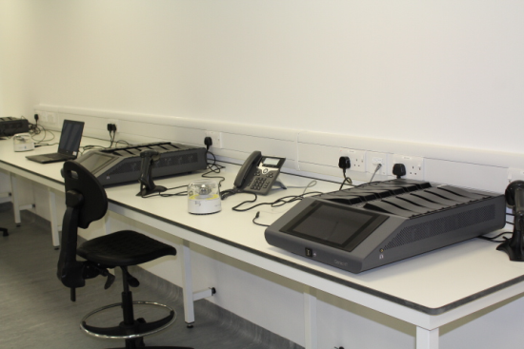
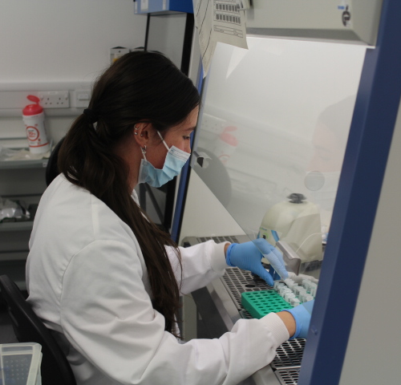
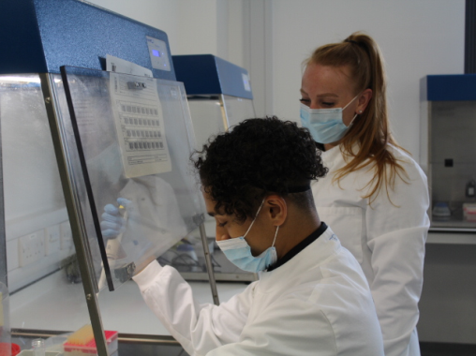
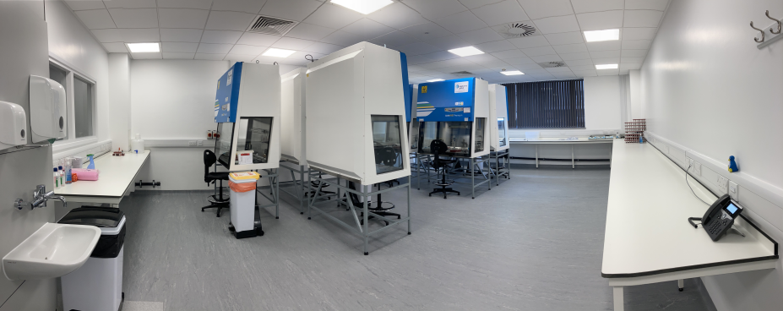
In December 2020, Liverpool Clinical Laboratories were invited to validate a new test for COVID-19 which utilized a new technology: The OptiGene RT-LAMP (loop-mediated isothermal amplification) test. This test was to be used for the asymptomatic screening of COVID-19 for NHS staff. Fast forward 10 months, and there is now a fully operational laboratory based in the Liverpool School of Tropical Medicines Accelerator Building. The laboratory processes close to 10,000 samples per week for the entire Cheshire and Merseyside Region. Whilst also providing a crucial service, the national statistics show that it is the most efficient and productive service of its type in the country. Processing the most samples per week with excellent turn around times.

Slide 3
Creation of the LAMP Laboratory
Location
Finding the right location for the laboratory was crucial as the space required was very specific. With the assistant of the Liverpool School of Tropical Medicine, the LAMP laboratory found it’s home in the Accelerator Building.
Kitting the Laboratory
The next stage was to kit the empty laboratory space with the necessary equipment. Our partners at the Department of Health and Social Care supplied all of the analytical equipment and consumables needed for the department
Recruitment & Training
With space and equipment supplied, the next stage was to staff the department. LUFT partnered with the University of Liverpool to recruit a large team of staff. Providing our local students with valuable laboratory experience and the department with a large flexible work force.
Go Live & Roll Out
The final stage was to offer LAMP testing out to the region. With the support of the Cheshire and Merseyside Health Care Partnership LAMP testing was rolled out to 12 trusts.

Slide 4
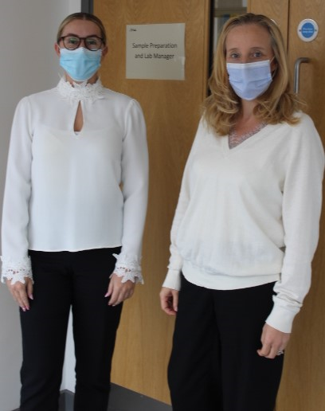
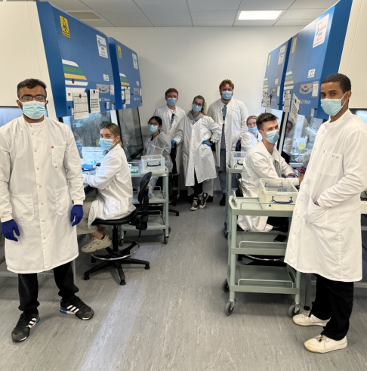
Workforce behind LAMP
The team is managed by two Laboratory Operational Managers seconded from other positions within LCL; Emma Larne a Senior Biomedical Scientist in Biochemistry and Hannah Williams a Senior Biomedical Scientist in Haematology. Both of the laboratory managers had no experience in molecular virology but were resolved to making the laboratory a success.
Being a part of LCL, the LAMP Laboratory has received support from all of our other LCL departments. The IT team developed and implemented a unique sample tracking system along with a text messaging service, the customer care team supported with service user queries and results and the Senior Management Team provided support and guidance.
Emma Larne & Hannah Williams
The LAMP lab would not exist, or be the success it is, without its dedicated workforce. The day to day operational team consists of Medical Laboratory Assistants, Associate Practitioners and Biomedical Scientists. A large portion of our workforce are students at the University of Liverpool. This staffing model has been mutually beneficial as most of the students have been unable to work in their university laboratories due to the pandemic, therefore working in LAMP has provided them with valuable laboratory experience.

Slide 5
LAMP Laboratory Achievements
GO LIVE
The LCL LAMP laboratory was the first lab in the country to ‘go live’ with the approval and sign off of the national team in January 2021
LAMP
ROLL OUT
LAMP successfully rolled out to all front line staff within the region therefore it was opened to all NHS staff working within the 12 trusts, including community workers
KEEP GOING
AUTOMATION
Due to the success of the lab and the ever growing numbers of samples we were asked to be a pilot site for the robotic automation, which is now being implemented in LAMP labs across the country
ALMOST THERE
BEST LAMP LAB
Since going live the LCL LAMP Laboratory is the largest laboratory of its kind processing the most samples and paving the way for other laboratories in the country
AWARD NOMINATIONS
We have now been nominated for LUFT Team of the Year and the CSO “Excellence in Healthcare” Awards
SUCCESS

